Slide 1


North Carolina Asthma Statistics: Nothing to Wheeze At
Farnaz Chowdhury
North Carolina Department of Health & Human Services Division of Public Health
State Center for Health Statistics

Slide 2
Adult Asthma
Prevalence

Slide 3
2016 Adult Asthma Prevalence,
Current & Lifetime: U.S. & N.C.
Notes:
https://www.cdc.gov/asthma/brfss/2016/tableC1.htm --- 2016 UPDATE HERE
https://www.cdc.gov/asthma/brfss/2016/tableL1.htm --- 2016 UPDATE HERE
As you can see, North Carolina’s adult asthma prevalence rates fall slightly below the US average for both lifetime and current asthma. Lifetime asthma prevalence refers to folks that indicated on the BRFSS telephone survey that they had EVER been diagnosed with asthma. The Current Asthma BRFSS question asks, among those who report that they have ever been diagnosed, “Do you still have asthma?”

Slide 4
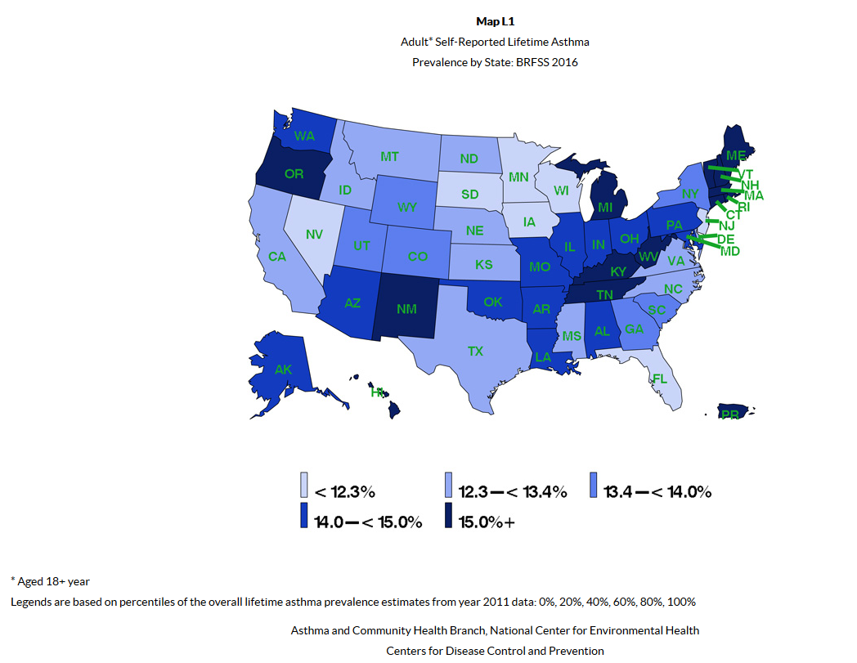
Notes:
https://www.cdc.gov/asthma/brfss/2016/mapL1.htm -- 2016 UPDATE HERE

Slide 5
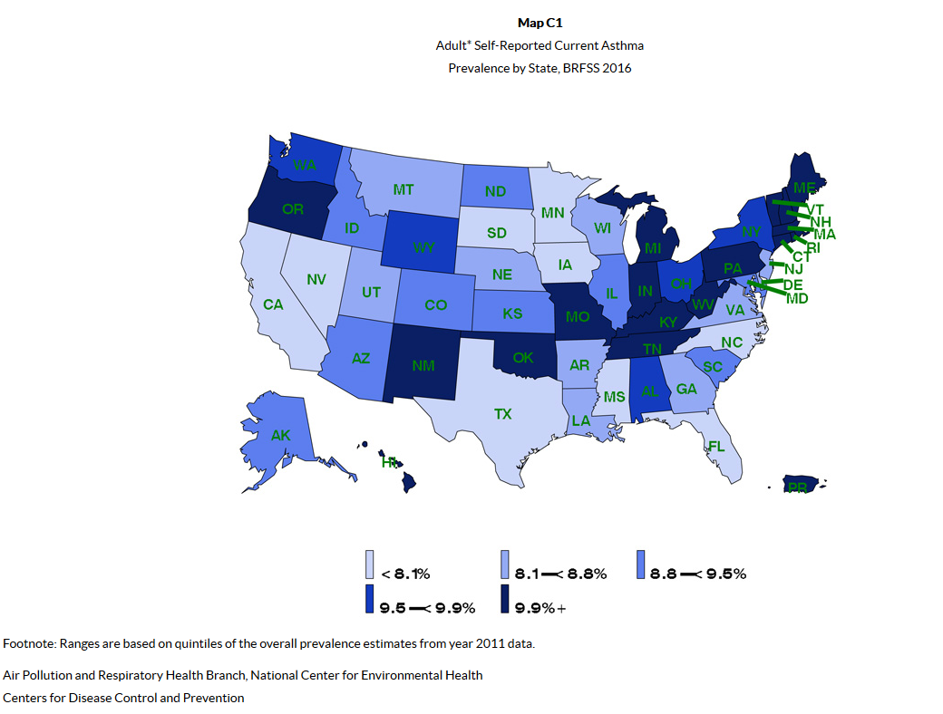
Notes:
https://www.cdc.gov/asthma/brfss/2016/mapC1.htm -- 2016 UPDATE HERE
When we look at the rate of Current Asthma prevalence among adults in 2016, North Carolina’s rate 8.0%.

Slide 6
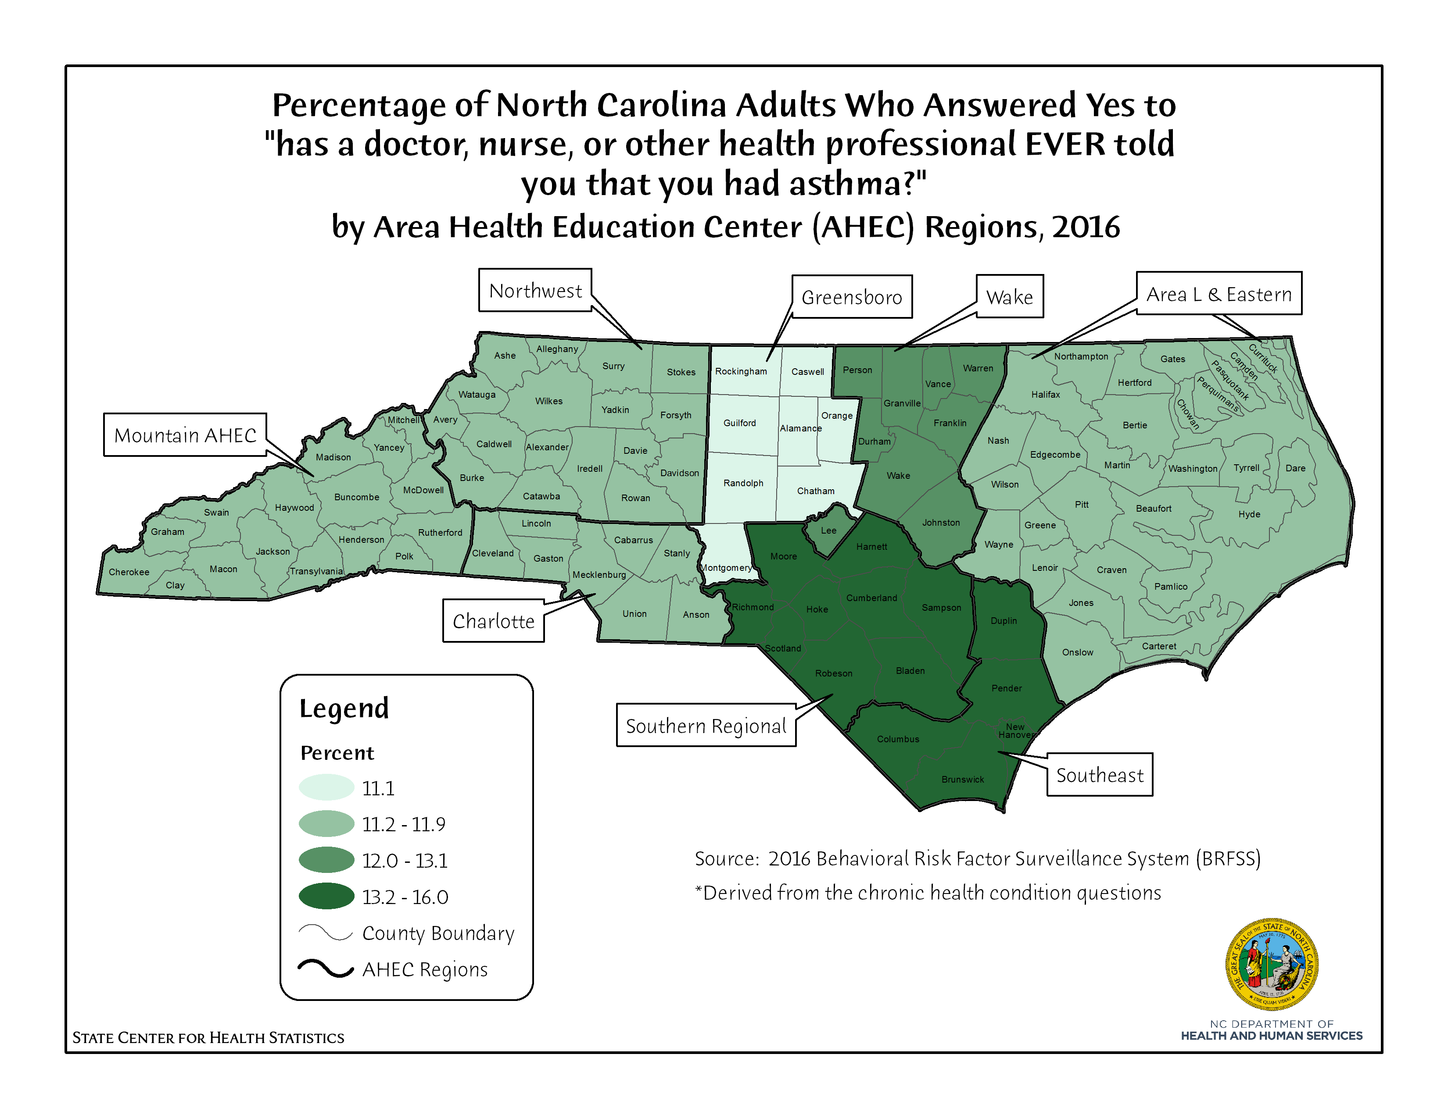

Slide 7
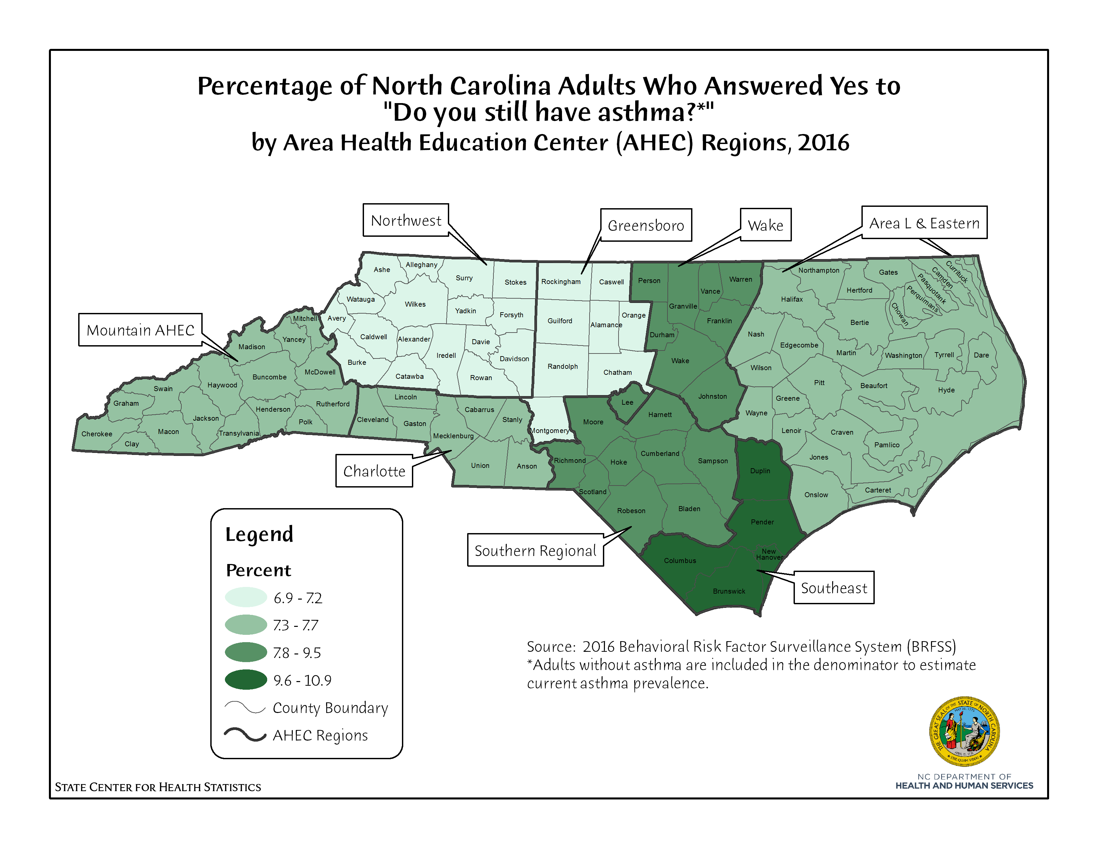

Slide 8
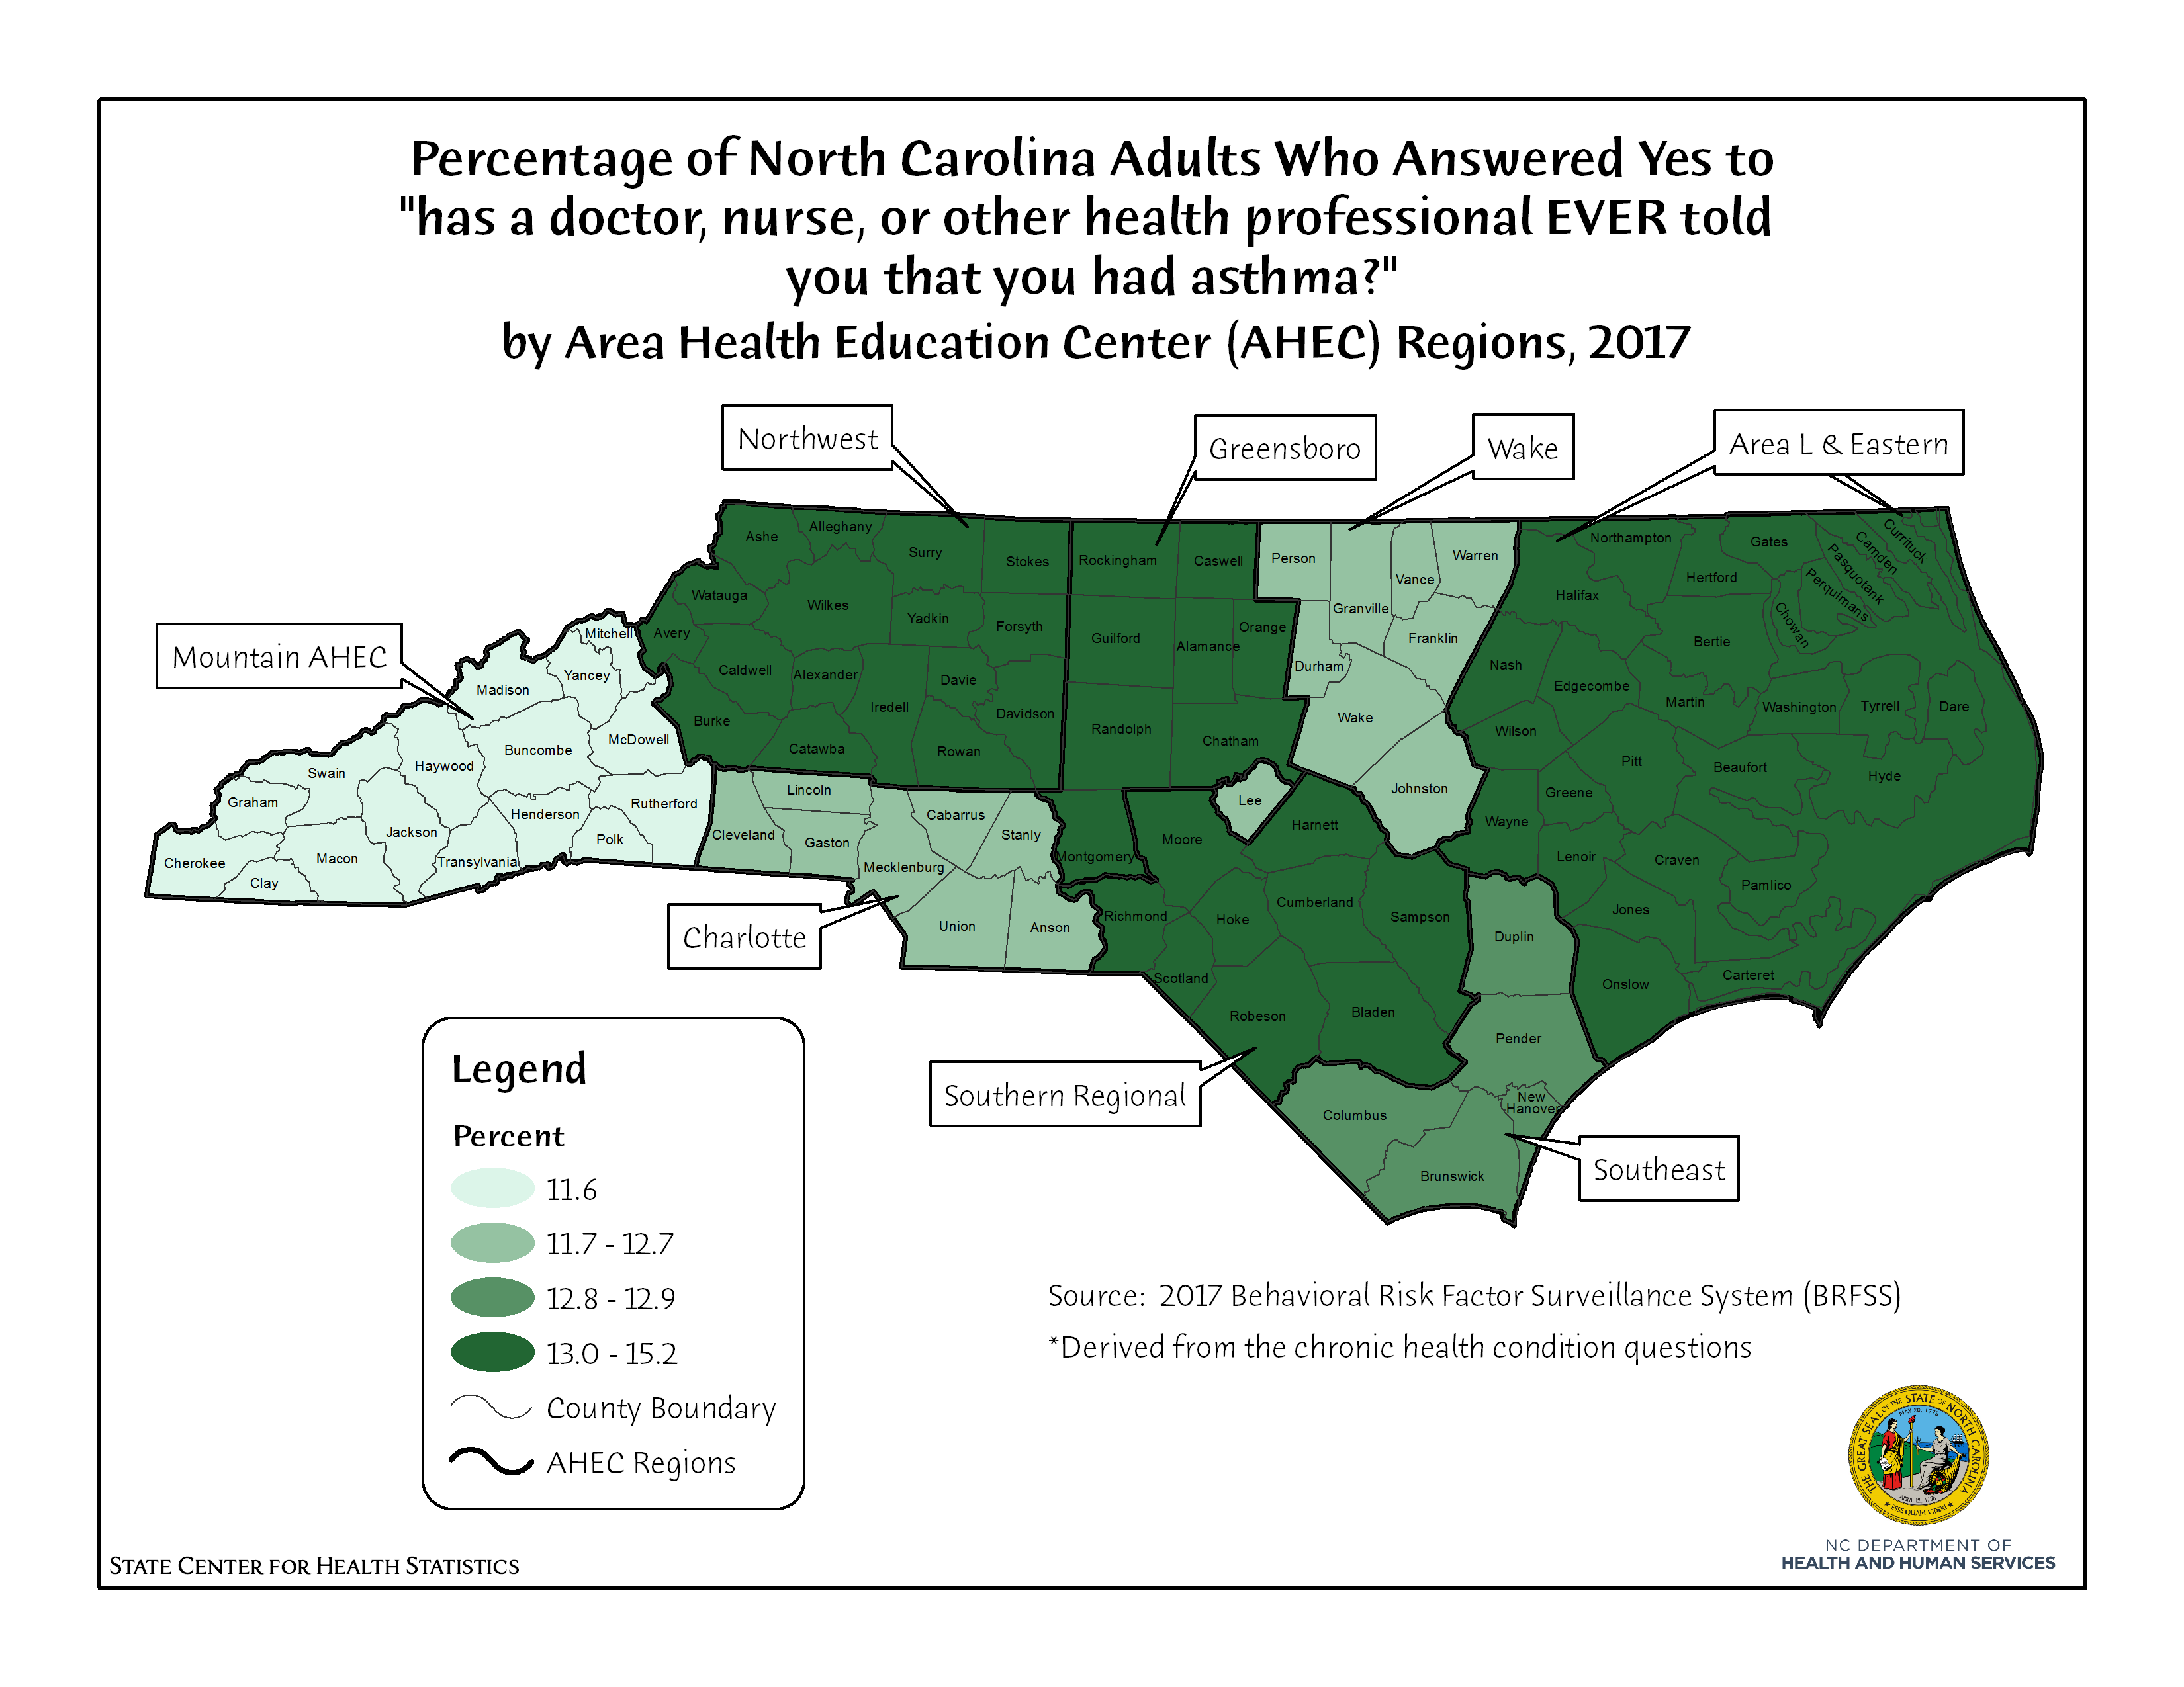

Slide 9
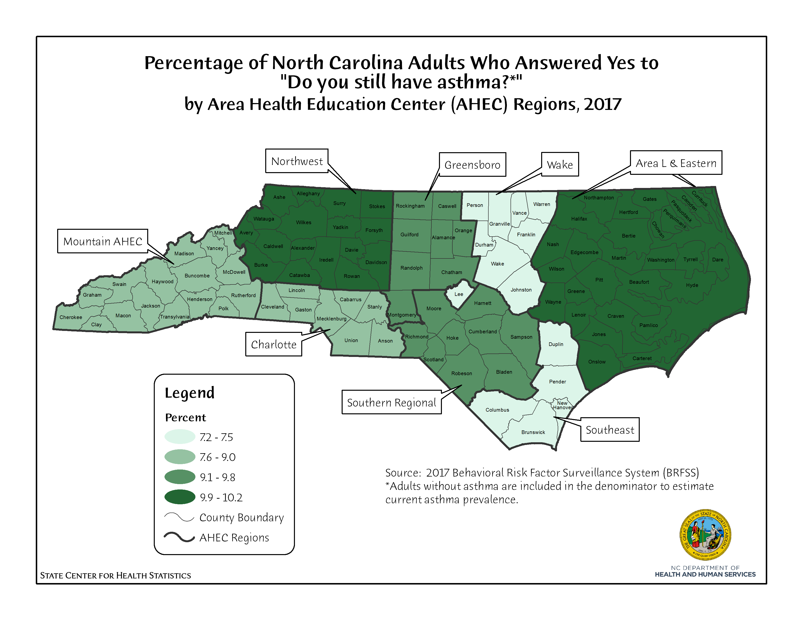

Slide 10
NC Adult Current Asthma Prevalence
Rates by Gender, 2016
Notes:
Adult women are more likely to report current asthma than males.
https://schs.dph.ncdhhs.gov/data/brfss/2016/nc/all/ASTHNOW.html

Slide 11
NC Adult Current Asthma Prevalence
Rates by Gender, 2017
Notes:
Adult women are more likely to report current asthma than males.
https://schs.dph.ncdhhs.gov/data/brfss/2017/nc/all/ASTHNOW.html

Slide 12
NC Adult Current Asthma Prevalence
Rates by Race/Ethnicity, 2016

Slide 13
NC Adult Current Asthma Prevalence
Rates by Race/Ethnicity, 2017

Slide 14
NC Adult Current Asthma Prevalence
Rates by Age Group, 2016

Slide 15
NC Adult Current Asthma Prevalence
Rates by Age Group, 2017

Slide 16
NC Adult Current Asthma Prevalence
Rates by Household Income, 2016
Notes:
Adult asthma rates by household income shows that asthma rates climb as household income declines. 13.9% of adults making less than $15,000 a year report currently having asthma, compared with only 6.3% of those with household incomes of $75,000 or more.

Slide 17
NC Adult Current Asthma Prevalence
Rates by Household Income, 2017
Notes:
Adult asthma rates by household income shows that asthma rates climb as household income declines. 15.9% of adults making less than $15,000 a year report currently having asthma, compared with only 6.2% of those with household incomes of $75,000 or more.

Slide 18
NC Adult Current Asthma Prevalence
by Comorbid Conditions/Risk Factors, 2016
*Disability Status phasing out next year, being replaced by Functional Disability.
Notes:
Finally, it’s important to keep in mind that asthma does not occur in a vacuum. Asthma is commonly reported among respondents with other conditions and risk factors that might exacerbate their condition. As shown in this graph, in 2016, a third of adults with COPD report having asthma. Almost one in five report adults that are disabled report current asthma, and more than one in ten smokers, diabetics, obese adults, and adults with CVD report having asthma. Nearly 8% of uninsured adults report having asthma.
https://schs.dph.ncdhhs.gov/data/brfss/2016/nc/risk/ASTHNOW.html

Slide 19
NC Adult Current Asthma Prevalence
by Comorbid Conditions/Risk Factors, 2017
Notes:
Finally, it’s important to keep in mind that asthma does not occur in a vacuum. Asthma is commonly reported among respondents with other conditions and risk factors that might exacerbate their condition. As shown in this graph, in 2017, a third of adults with COPD report having asthma. More than one in ten smokers, diabetics, obese adults, adults with CVD, and adults with functional disability report having asthma. Nearly 10% of uninsured adults report having asthma.

Slide 20
Asthma Hospitalizations

Slide 21
2016 NC Resident Inpatient Hospitalizations for Asthma*
Total Hospital Discharges | 4,956
Discharge Rate per 100,000 Population | 48.8
Average Length of Stay (in days) | 2.8
Total Charges | $77,464,678
Average Charge per Day | $5,575
Average Charge per Hospitalization | $15,630
* Asthma as a Primary Diagnosis
Notes:
In 2016, there were 4,956 North Carolina resident hospital visits with asthma as listed as their primary or principal diagnosis. This equates to approximately 14 asthma hospitalizations every day. When examining the charges, please keep in mind that these figures represent the amount billed, not the amount actually paid. Typically hospital rates are negotiated and the amount paid could be a substantially smaller figure.

Slide 22
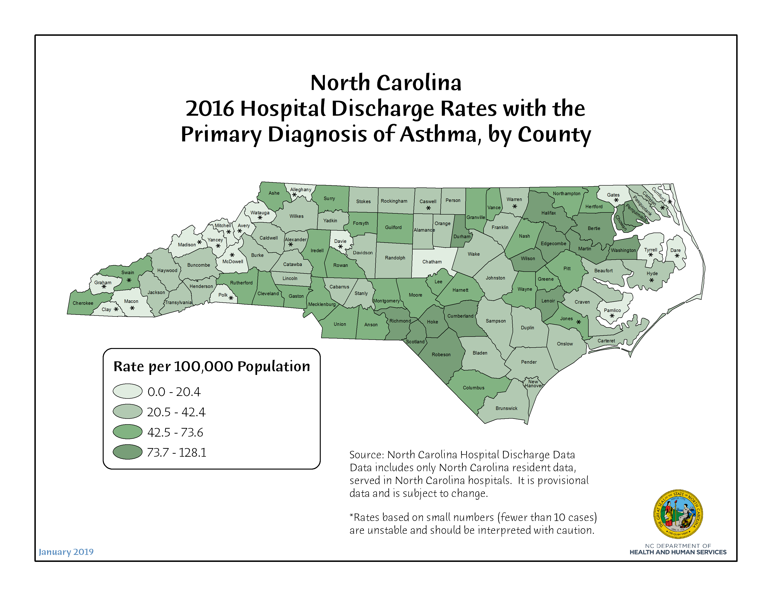
Notes:
This map presents asthma hospitalization rates for all ages by county. Rates are disperse, however similar patterns emerge. Again – eastern counties tend to have higher rates than western. However, a small number of asthma hospitalizations in many counties make interpretation more difficult.

Slide 23
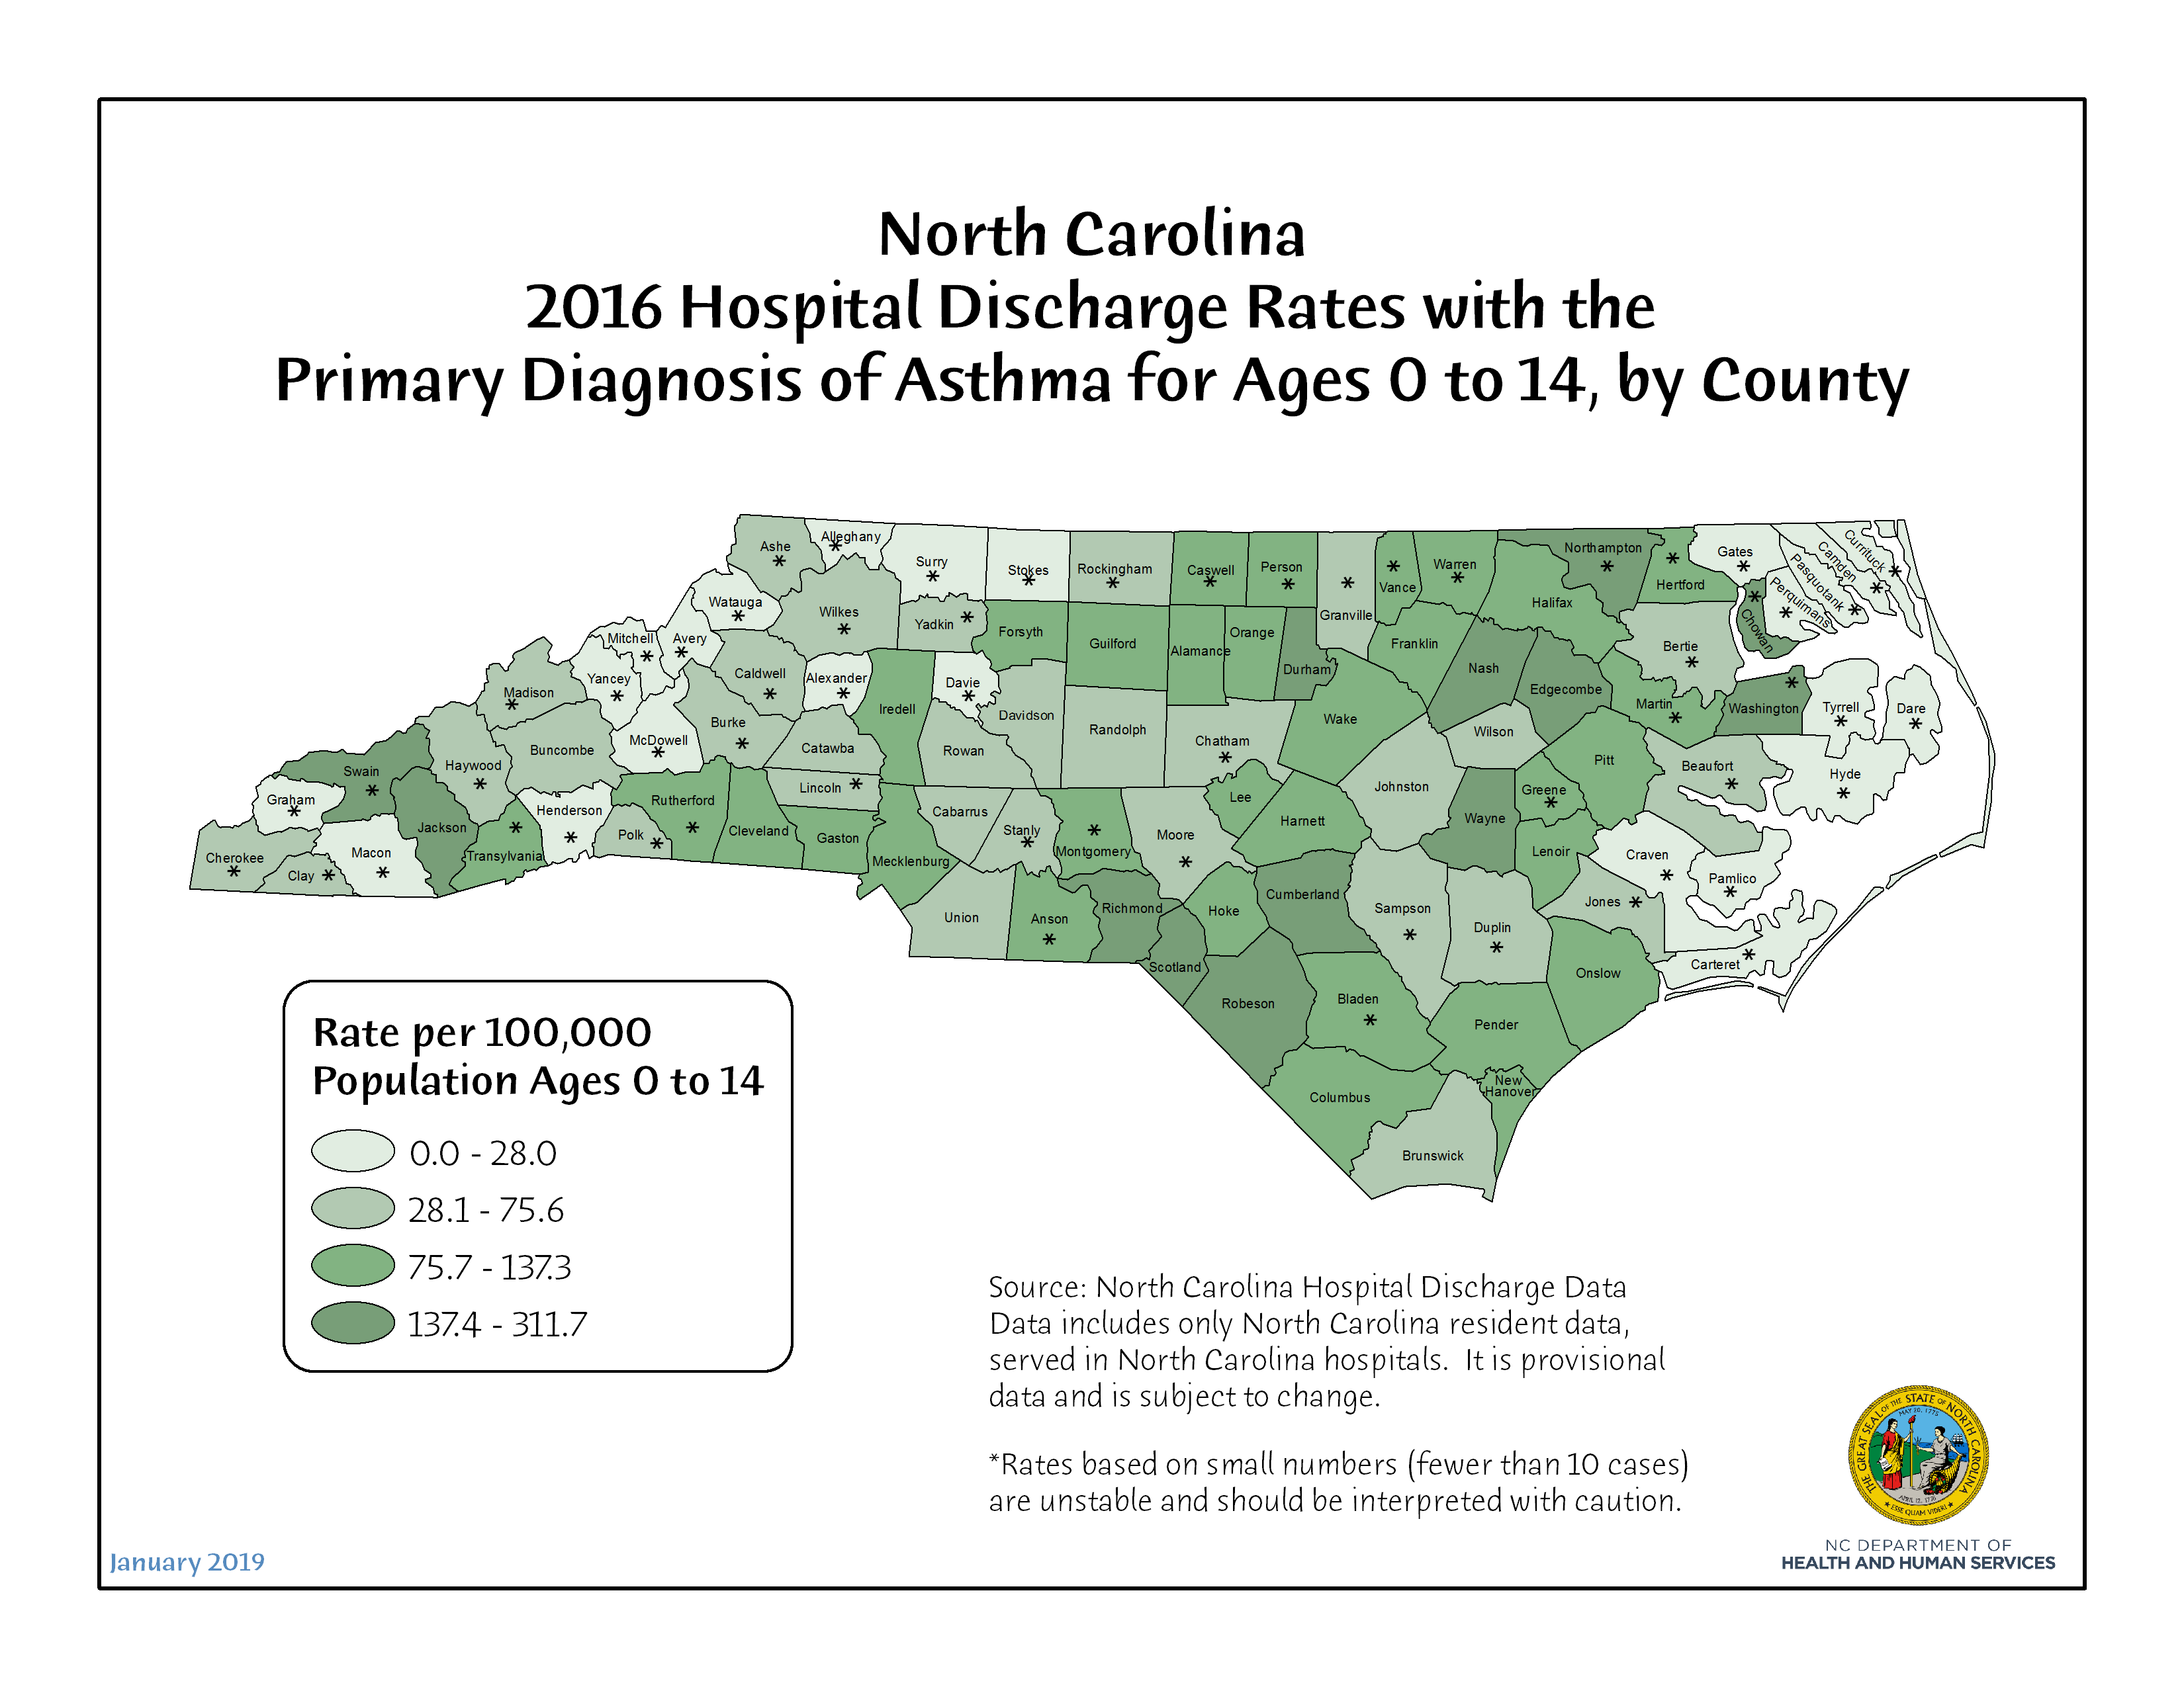
Notes:
This maps presents asthma discharge rates for children ages 14 and under. Again, eastern counties have higher rates. However, a small number of asthma hospitalizations among children in many counties (which is a good thing) make interpretation more difficult.

Slide 24
2017 NC Resident Inpatient Hospitalizations for Asthma*
Total Hospital Discharges | 4,954
Discharge Rate per 100,000 Population | 48.2
Average Length of Stay (in days) | 2.8
Total Charges | $85,777,254
Average Charge per Day | $6,116
Average Charge per Hospitalization | $17,315
* Asthma as a Primary Diagnosis
Notes:
In 2017, there were 4,954 North Carolina resident hospital visits with asthma as listed as their primary or principal diagnosis. This equates to approximately 14 asthma hospitalizations every day. When examining the charges, please keep in mind that these figures represent the amount billed, not the amount actually paid. Typically hospital rates are negotiated and the amount paid could be a substantially smaller figure.

Slide 25
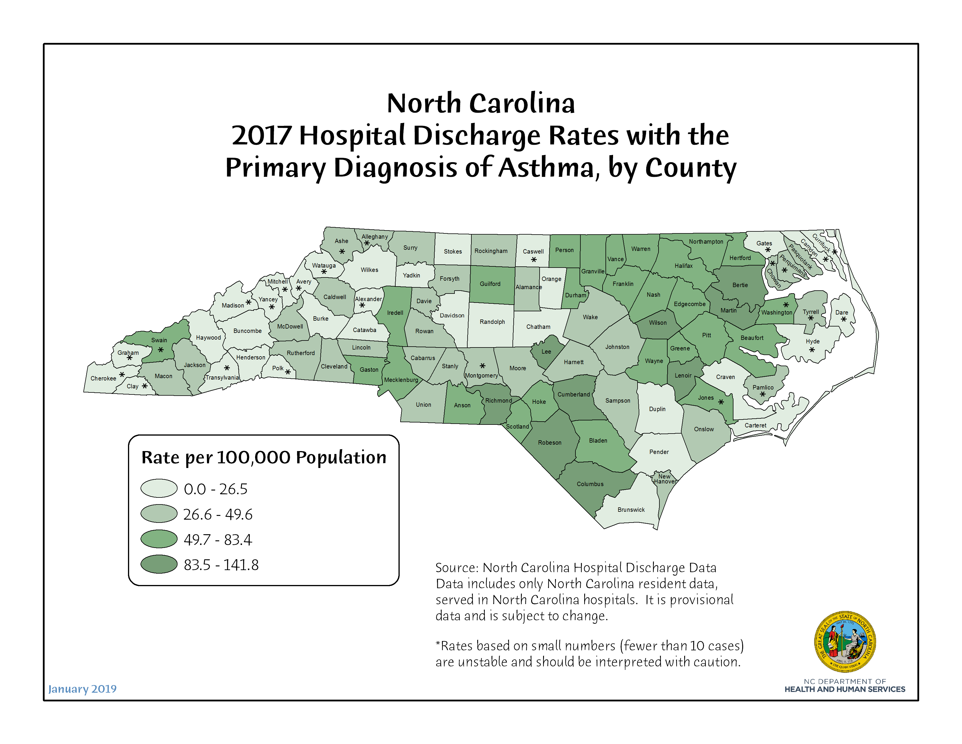

Slide 26
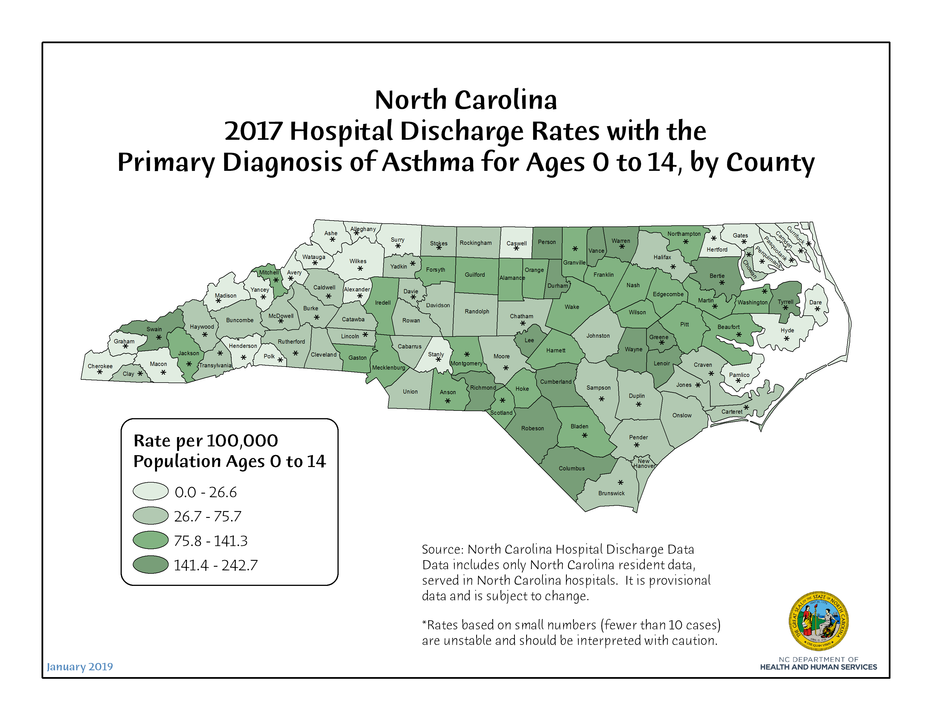

Slide 27
Asthma Mortality

Slide 28
2016 NC Resident Deaths Due to Asthma*
Total Asthma Deaths | 94
Crude (unadjusted) Mortality Rate | 9.3
Age-adjusted Mortality Rate | 8.9
* Asthma as a Primary Cause of Death
Notes:
Fortunately, mortality due to asthma is quite rare. In 2016, there were 94 deaths due to asthma among NC residents. Because we have so few deaths, we have to create asthma rates PER MILLION (Note: this is pretty much the only cause of death for which we do this). North Carolina’s age adjusted asthma mortality rate of 8.9 per million was below the overall U.S. rate of 10.0.

Slide 29
2017 NC Resident Deaths Due to Asthma*
Total Asthma Deaths | 102
Crude (unadjusted) Mortality Rate | 9.9
Age-adjusted Mortality Rate | 9.6
* Asthma as a Primary Cause of Death
Notes:
Fortunately, mortality due to asthma is quite rare. In 2017, there were 102 deaths due to asthma among NC residents. Because we have so few deaths, we have to create asthma rates PER MILLION (Note: this is pretty much the only cause of death for which we do this).

Slide 30
Emergency Department
Visits for Asthma

Slide 31
NC Emergency Visits for Asthma
(as a Primary Diagnosis) by Age Group, 2016
Age Group | Total Discharges | Crude Rate per 10,000 population
Ages 0-4 | 5,159 | 85.1
Ages 5-64 | 42,208 | 52.9
Ages 65+ | 2,357 | 15.0
Total | 49,724 | 49.0
Source: State Center for Health Statistics Emergency Department Data
Notes:
Overall, in 2016 there were more than 49,000 ED visits for asthma. Most of these occurring among the 5-64 age group. However, the 0-4 age group actually had the highest asthma ED visit rate.

Slide 32
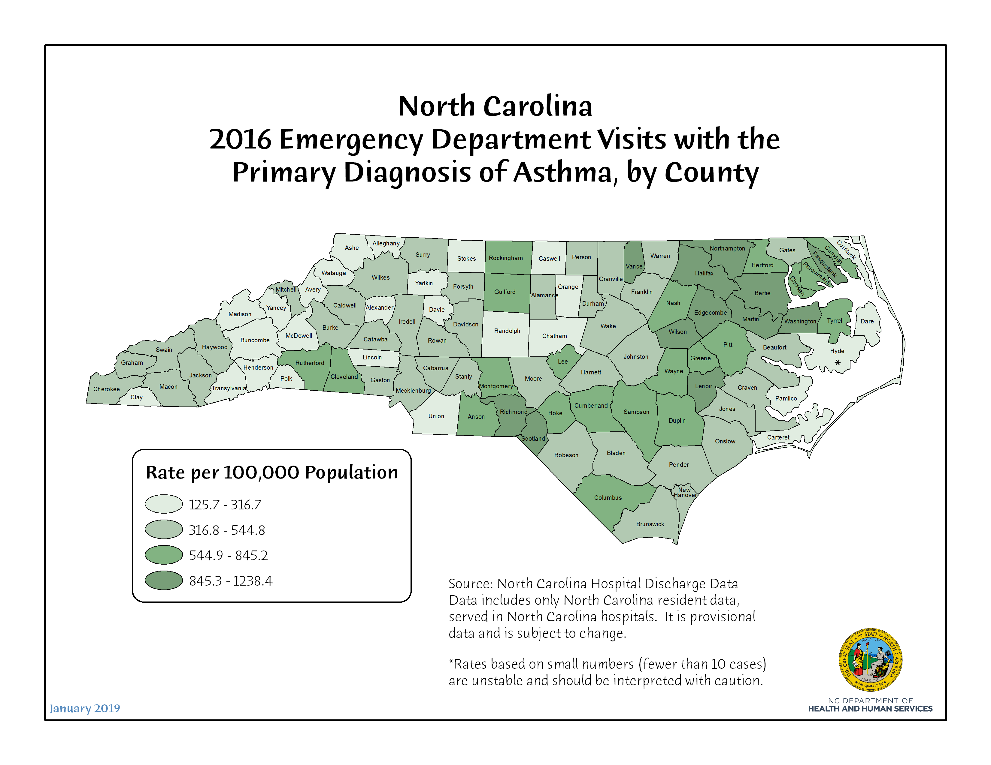

Slide 33
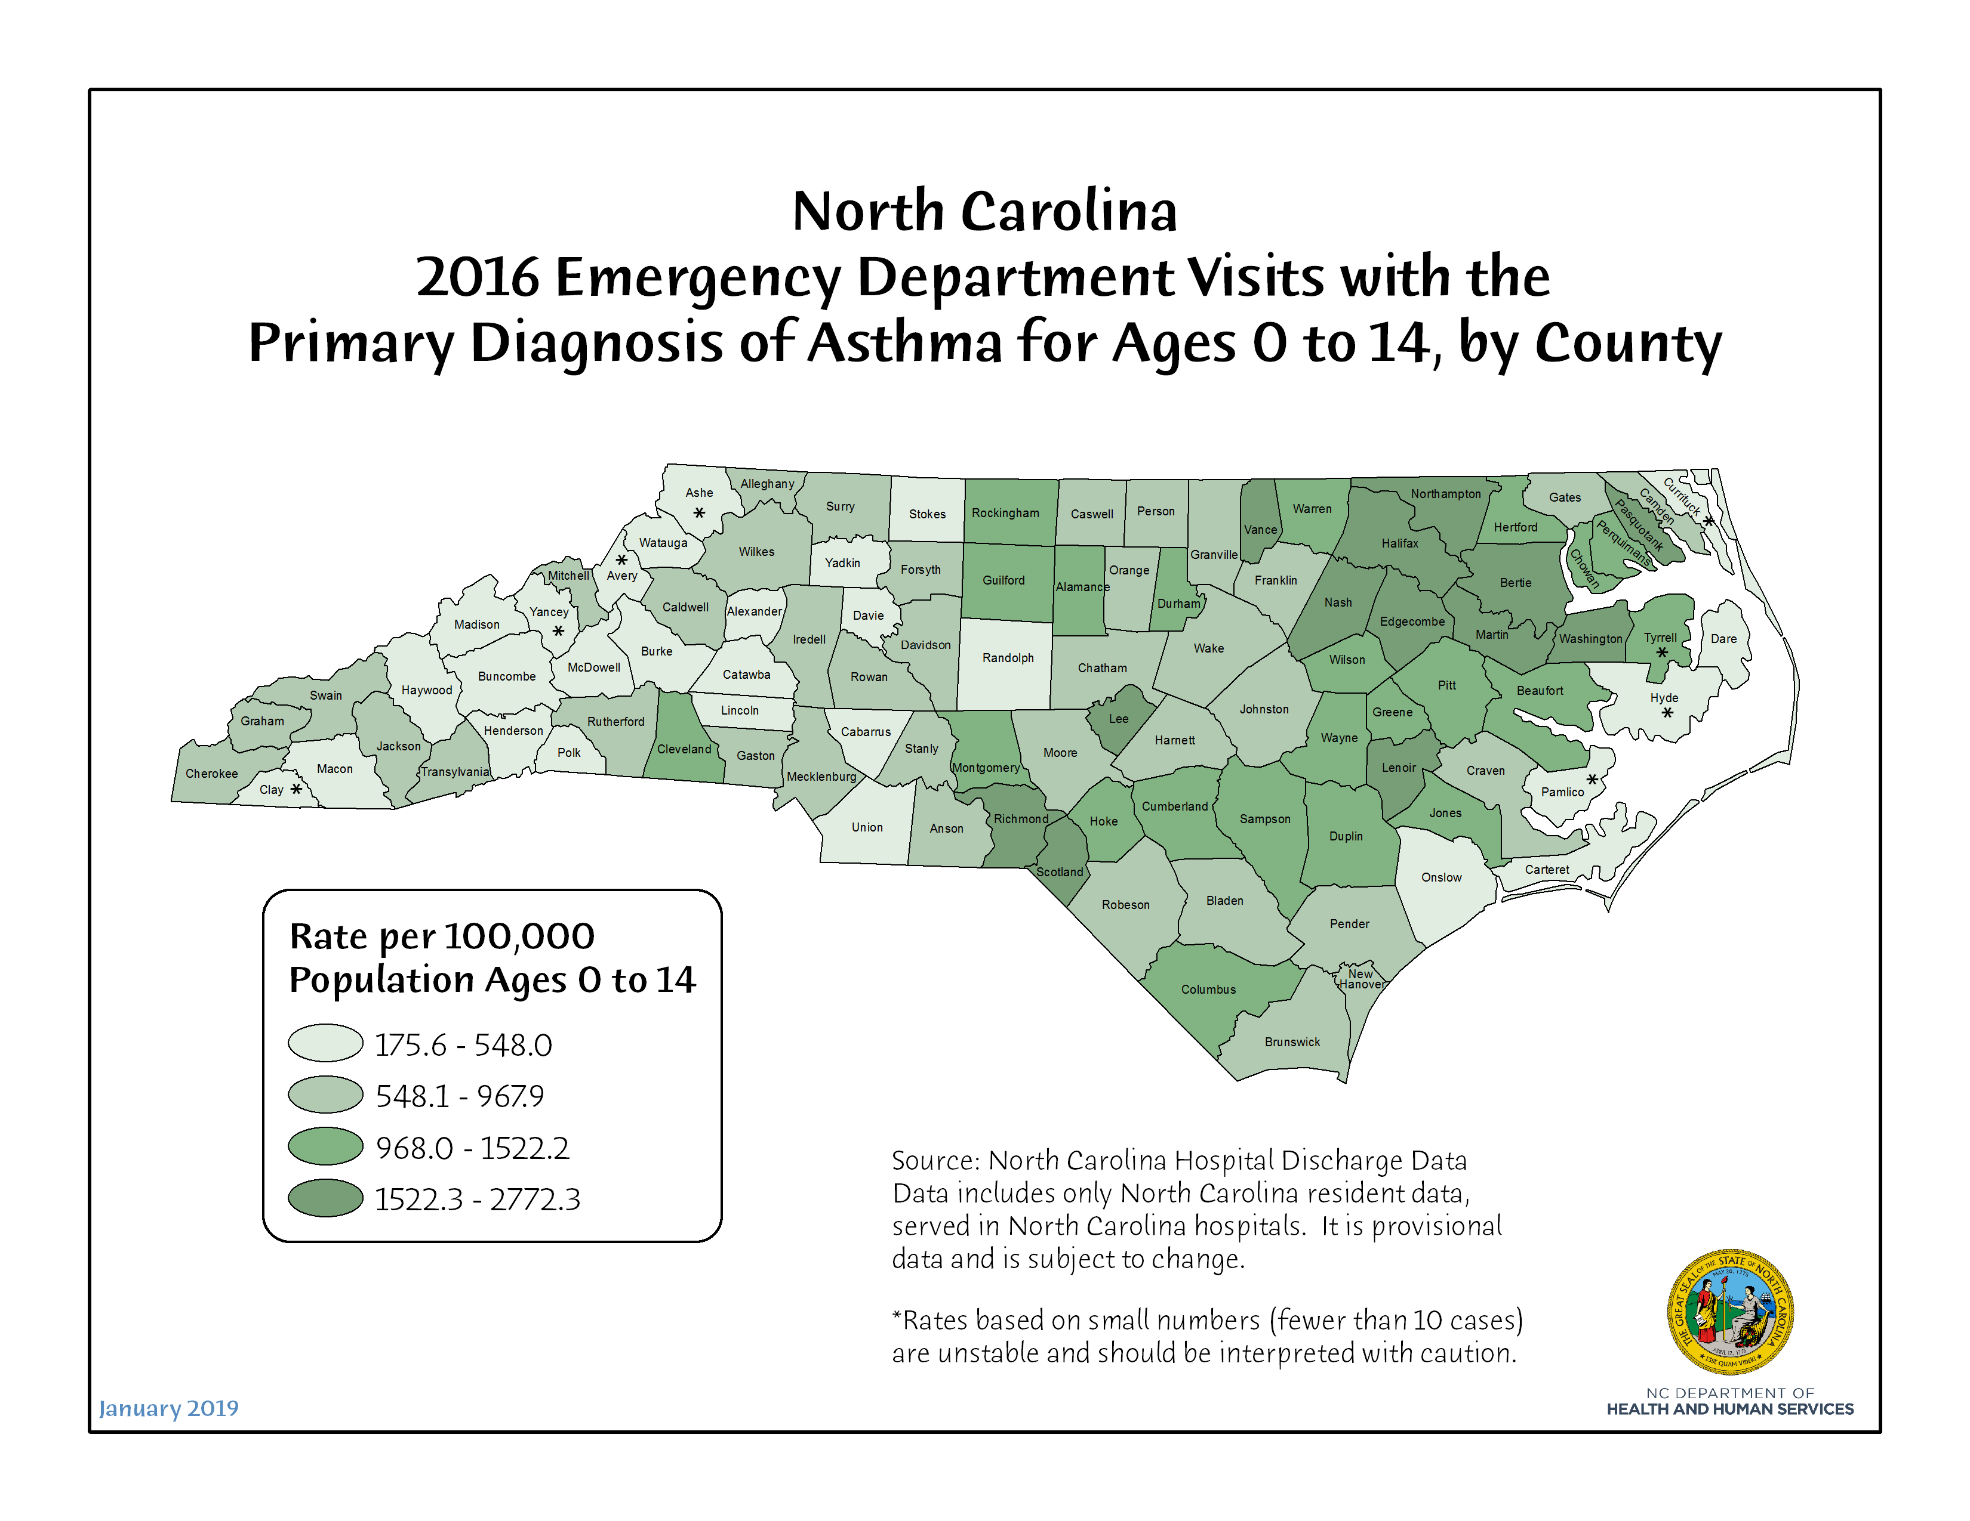

Slide 34
NC Emergency Visits for Asthma
(as a Primary Diagnosis) by Age Group, 2017
Age Group | Total Discharges | Crude Rate per 10,000 population
Ages 0-4 | 4,629 | 75.9
Ages 5-64 | 40,267 | 50.1
Ages 65+ | 2,503 | 15.4
Total | 47,399 | 46.1
Source: State Center for Health Statistics Emergency Department Data
Notes:
Overall, in 2017 there were more than 47,000 ED visits for asthma. Most of these occurring among the 5-64 age group. However, the 0-4 age group actually had the highest asthma ED visit rate.

Slide 35
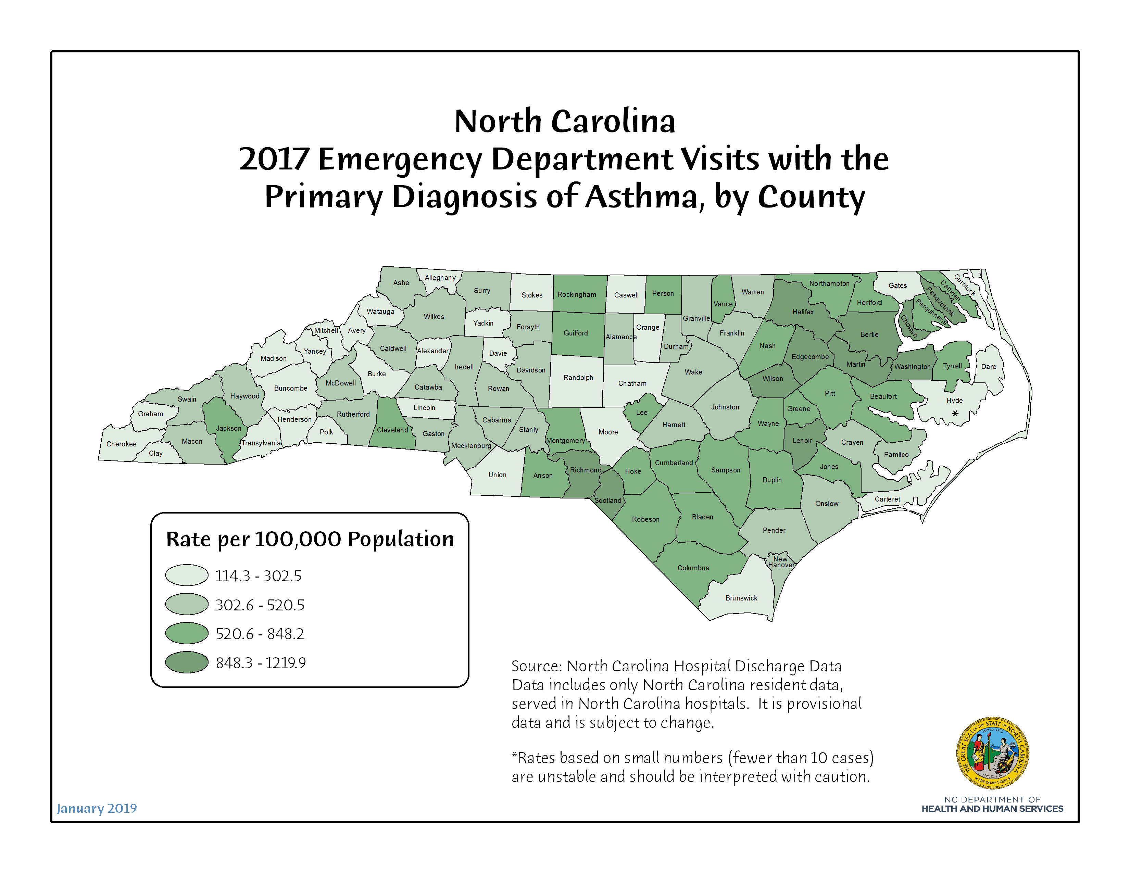

Slide 36
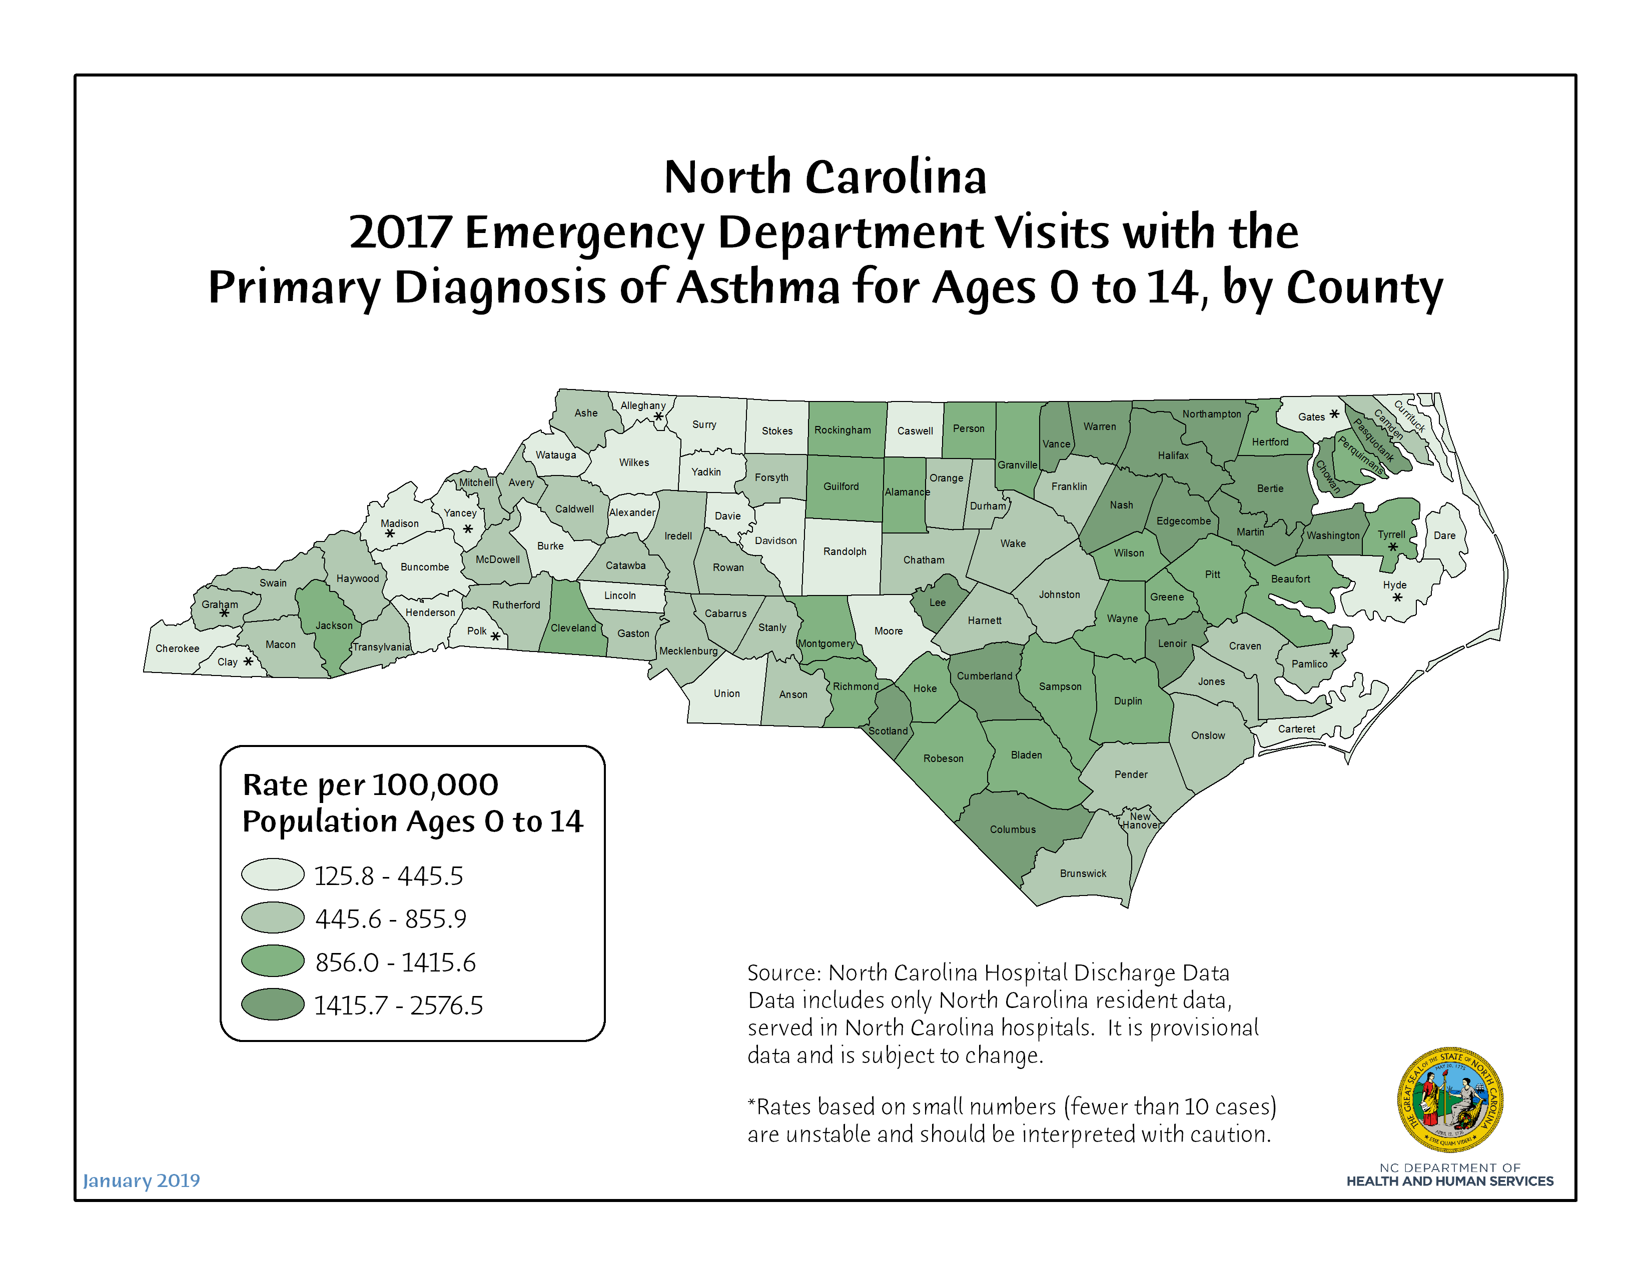

Slide 37
Asthma &
NC Children

Slide 38
Prevalence of Asthma
Among NC Children, 2016-17
 | Ever Asthma | Current Asthma
Total | 15.1% | 8.2%
Male | 18.4% | 8.4%
Female | 12.0% | 8.1%
White | 13.0% | 5.8%
African American/Black | 14.7% | 12.2%
Other Minorities | * | 13.2%
Hispanic | * | *
* Statistically unreliable estimate.
Source: North Carolina Child Health Assessment Monitoring Program (CHAMP)
Notes:
Our survey of CHAMP survey focuses on NC children and includes several questions on asthma. Acc. to CHAMP, about 15% of children ages 0-17 are reported to have asthma (as reported by parents recruited from the BRFSS survey).
https://schs.dph.ncdhhs.gov/data/champ/201617/k11q01.html
https://schs.dph.ncdhhs.gov/data/champ/201617/asm_cur.html

Slide 39
Most Common Chronic Health Conditions Reported to
School Nurses, 2016-17
Notes:
https://publichealth.nc.gov/wch/doc/stats/16-17-SN-AnnualReportBrochure-WEB.pdf
https://publichealth.nc.gov/wch/stats/

Slide 40
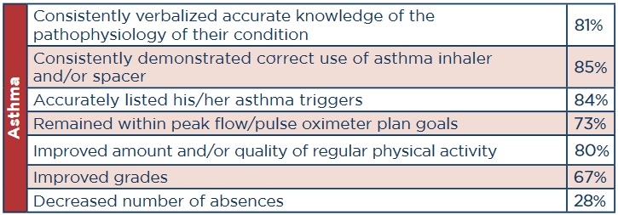
School Nurse Asthma
Case Management
Source: 2015-2016 NC Annual School Health Services Report
Notes:
https://publichealth.nc.gov/wch/doc/stats/15-16-AnnualSHSBrochureRev.pdf
School nurse care management of selected students with complex health needs involves use of a plan of care that includes specific interventions with achievable goals, measurable outcomes and regular evaluations. Students may have one or more planned outcomes based on identified needs. School nurses may care manage students with a variety of diagnoses. Not all chronic condition diagnosed students are in need of care management services. Care management outcomes for the following diagnosis are reported each school year.

Slide 41
Contact Information
Farnaz Chowdhury
N.C. Department of Health & Human Services
Statistician, State Center for Health Statistics-Division of Public Health
222 North Dawson Street
Raleigh, NC 27603-1392
Phone: 919-715-0554
Fax: 919-733-8485
farnaz.h.chowdhury@dhhs.nc.gov
www.schs.state.nc.us

